Slide 1
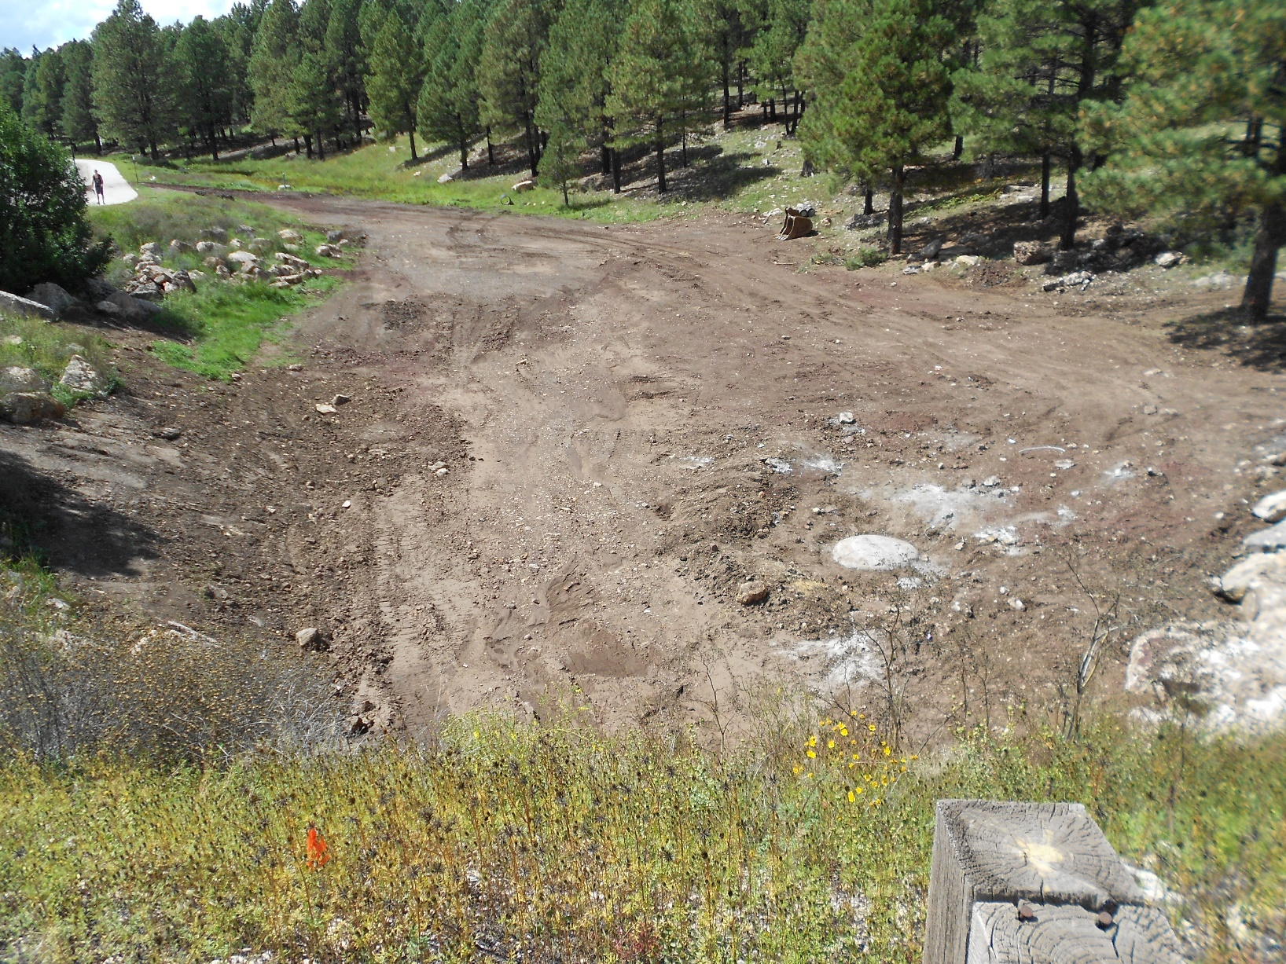
Sinclair Wash Initial Assessment
Sinclair Wash Team

Slide 2

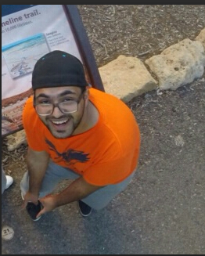


Team Introductions
Ryan King: Project Engineer-Hydrologist
Hasan Mohammand: Project Engineer
Leah Richardson: Project Manager
Holly Swenson: Engineering Technician
All

Slide 3
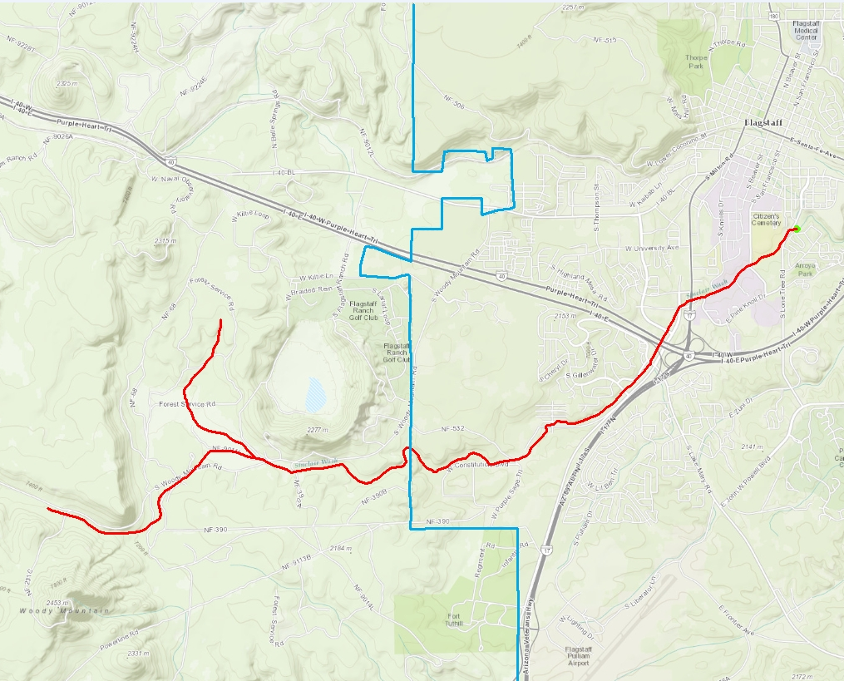
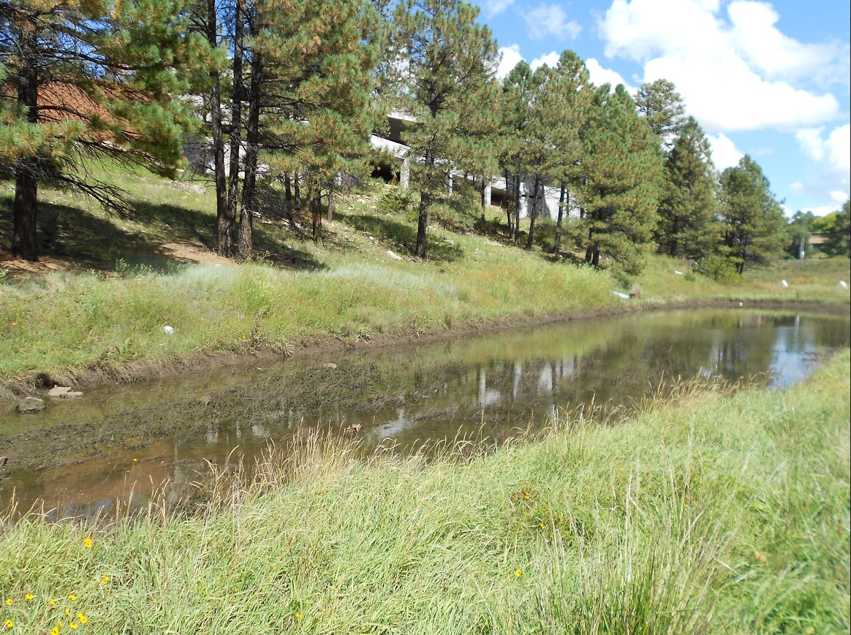
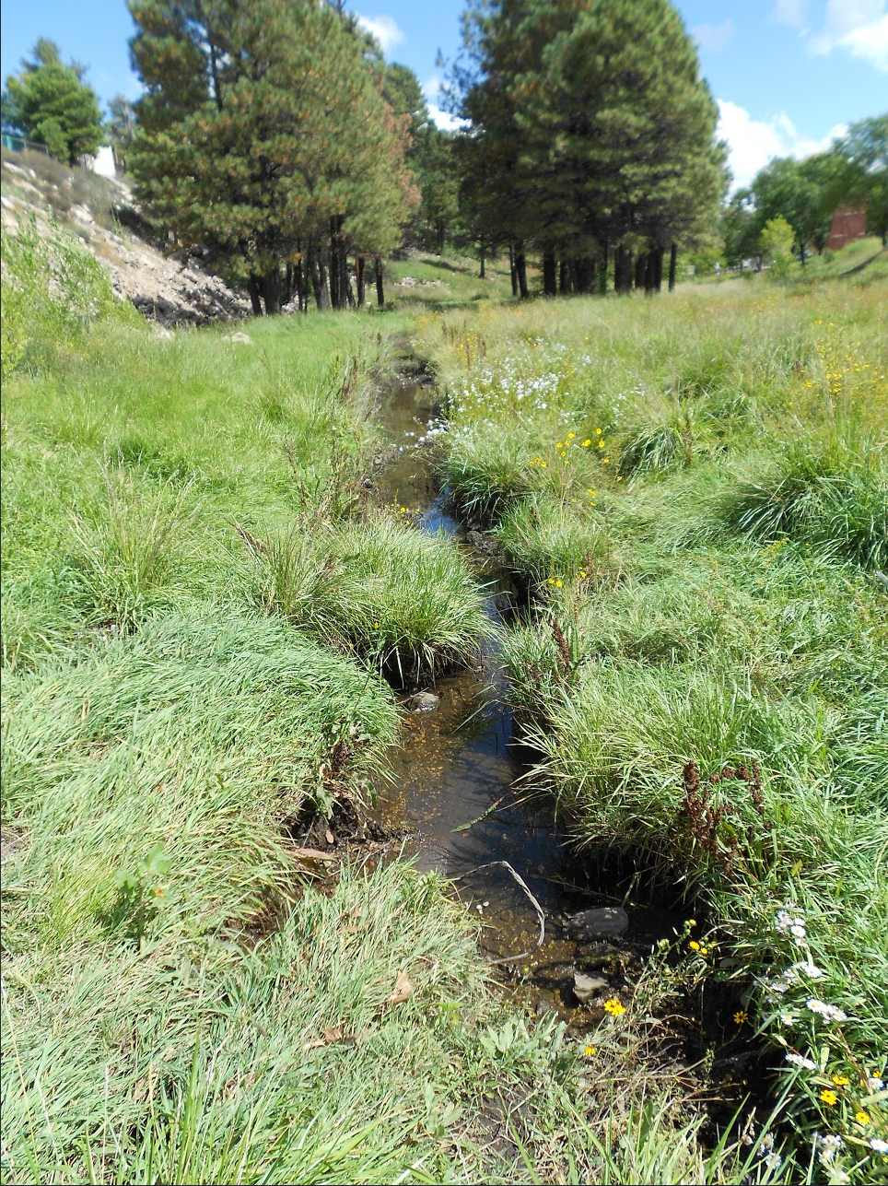
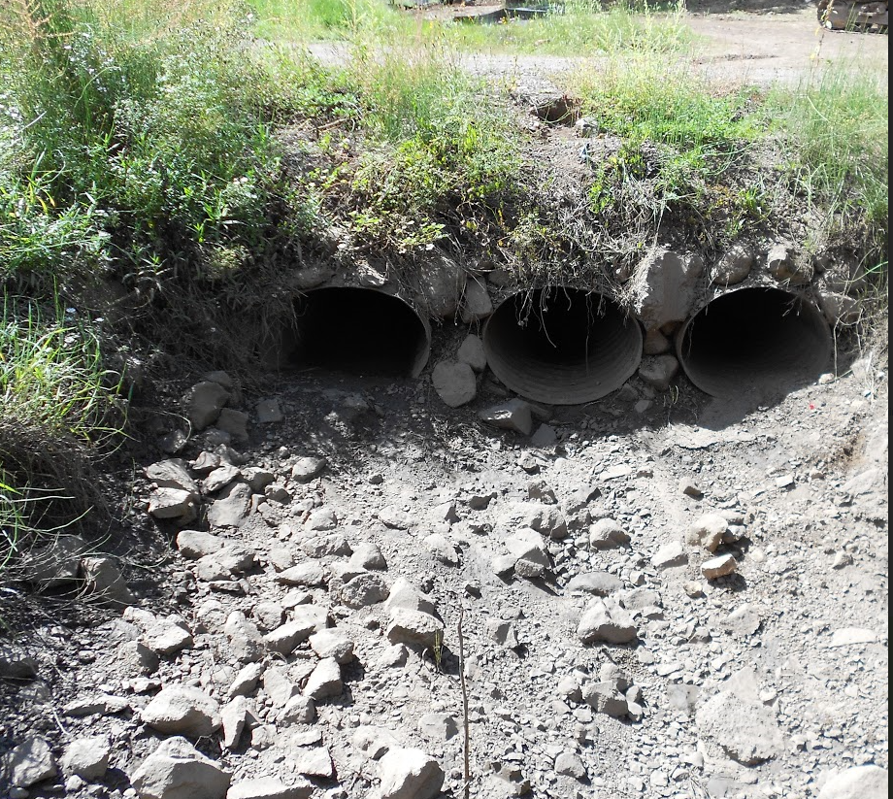
Project Description
Project Boundary
Current Condition
S Lone Tree Road
Walmart
Sinclair Wash
Woody Mountain Road
City Limits
King
* For all pictures: King W. (2014). Sinclair Wash Project. Unpublished Manuscript, CENE 486 Capstone, Northern Arizona University, United States.
Notes:
Flows from the northwest base of Woody Mountain, connects to the Rio de Flag near S Lone Tree Road
Very straight and narrow so during any rain, water overflows the confines of the stream allowing water to go any where promoting pooling in random areas (marsh like)
CMPs go under every trail crossing. Due to settling, they are often at the lowest points of the wash so serious pooling occurs right before an right after the inlet structure
Permanent pond structure near the end of our boundary following restored portion of reach. Right before the end of our boundary

Slide 4
Purpose
Initial assessment of the Sinclair Wash
Identifying problem areas
Initial conditions modeling
Achieved through
Surveying
Analysis
Swenson
Notes:
Purpose-to evaluate and analyze the potential of a restoration project along an unhealthy stream called Sinclair Wash.
Operation : This wash is supposed to operate as an ephemeral stream, preserving and continuing a healthy habitat by transporting flood flows, sediment, and nutrients downstream.
Why : When functioning properly, these streams reduce erosion, improve water quality, provide groundwater recharge and aid in floodplain maintenance.
Team goals : The team’s main goal is to use tools such as site visits, surveying, hydrologic analysis, hydraulic analysis, mapping and comparisons to healthy parts of the reach to determine the feasibility of a Sinclair Wash improvement plan which includes: increasing plant diversity, improving the current eco life, saving cultural heritage, extending recreational opportunities and improving the overall function of the stream channel.

Slide 5
Client, Technical Advisor, Stakeholders
Client: David McKee, City of Flagstaff Storm Management Section
Technical Advisor: Mark Lamer
Stakeholders: Citizens of Flagstaff, Northern Arizona University, Private Property Owners and Environment
Swenson

Slide 6
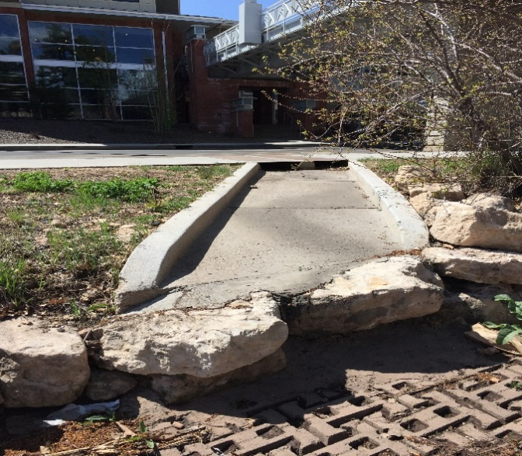
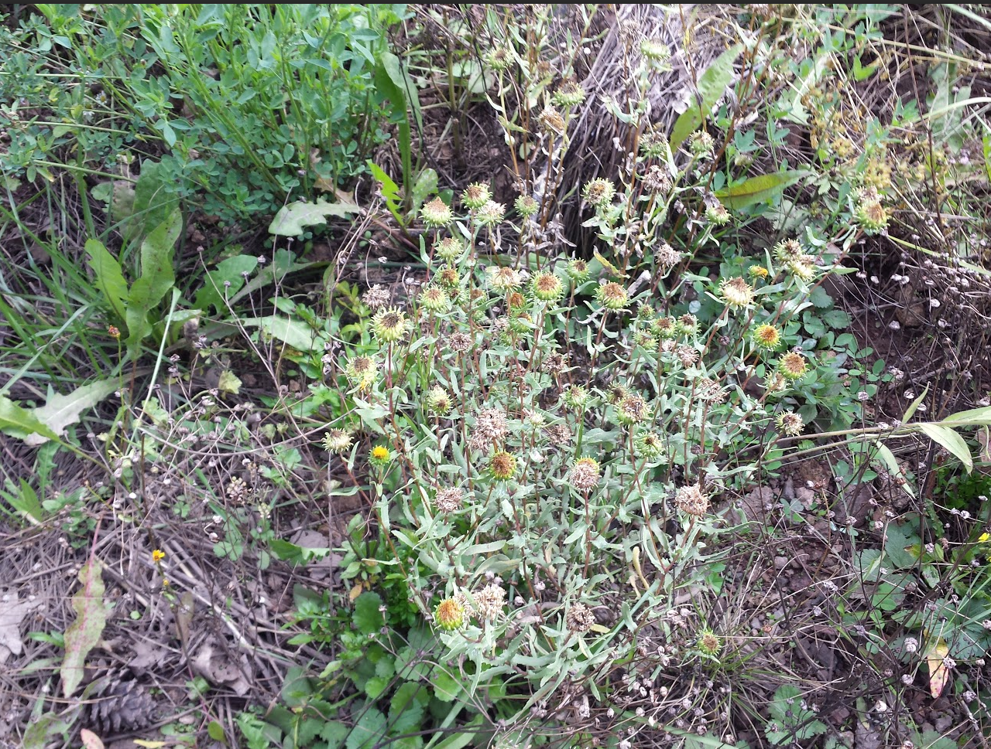
Inventory
Determined location and size of all outlet structures in wash
Invasive species
Measured all culverts within city limits
CulvertMaster for max capacity
City Specifications
Type/Structure | Culvert | Inlet | Open Inlets
PVC |  | 3
1-CMP |  | 11
2-CMP | 1
3-CMP | 5 | 1
DBC | 6
Concrete |  | 4 | 4
Total | 12 | 19 | 4
Mohammad

Slide 7
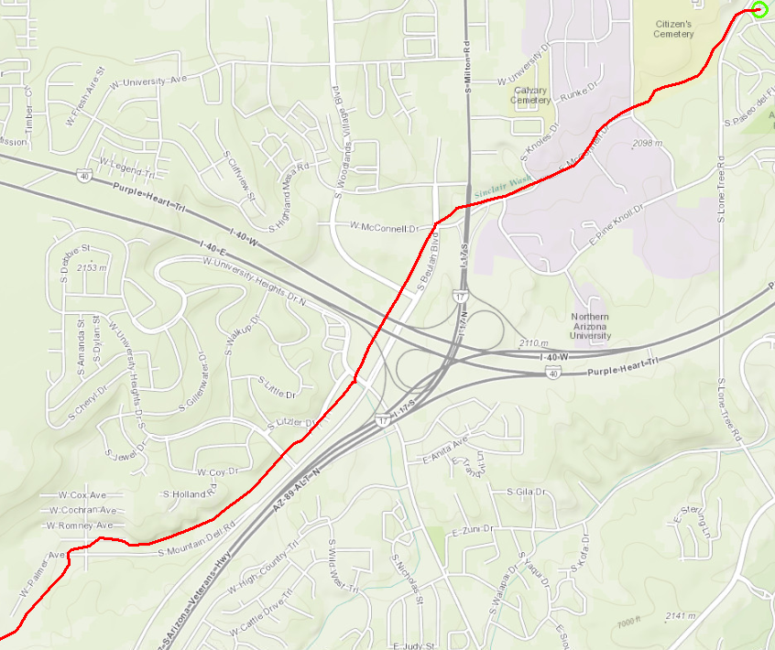
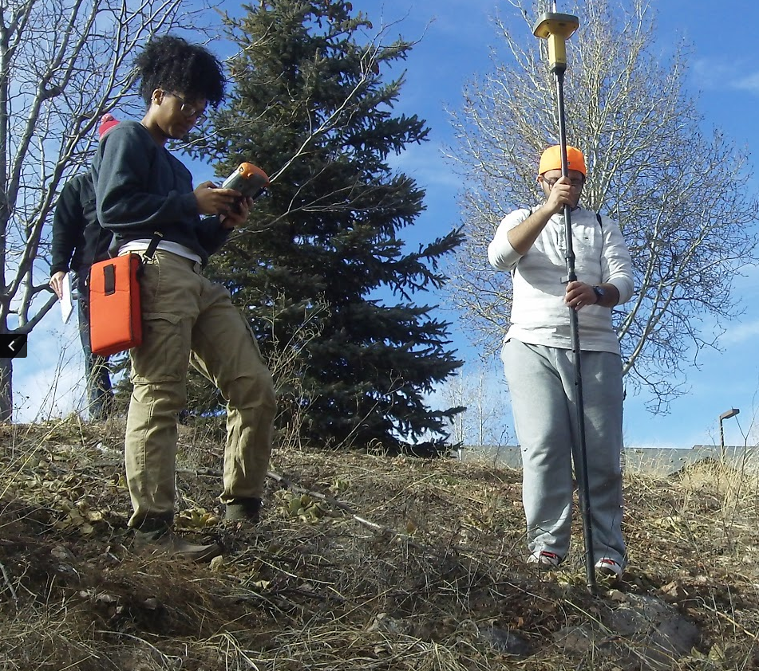
Survey
San Francisco St
5
Surveyed cross-sections at 5 locations
TOPCOM GR-3 GPS unit
Input into Civil 3D to develop surfaces
5 alignments
Surveyed cross-sections served as sample lines
4
Walmart
3
Big 5
2
University Heights Dr
1
Mohammad

Slide 8
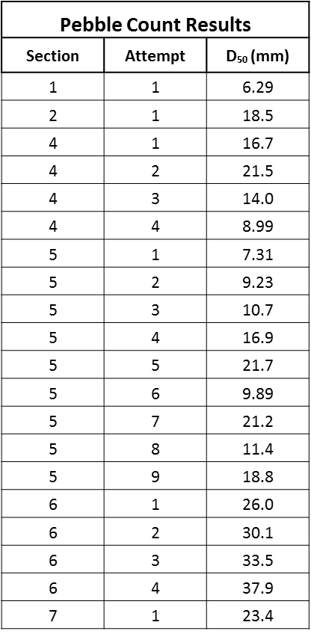
Soil Analysis
Sieve Analysis to classify soil
Clean sand or clayey sand (USCS)
Hydrologic Group D: clay sand (USDA)
Pebble Count
Modified Wolman method
Grid
Used to determine Manning’s coefficient, n
King

Slide 9
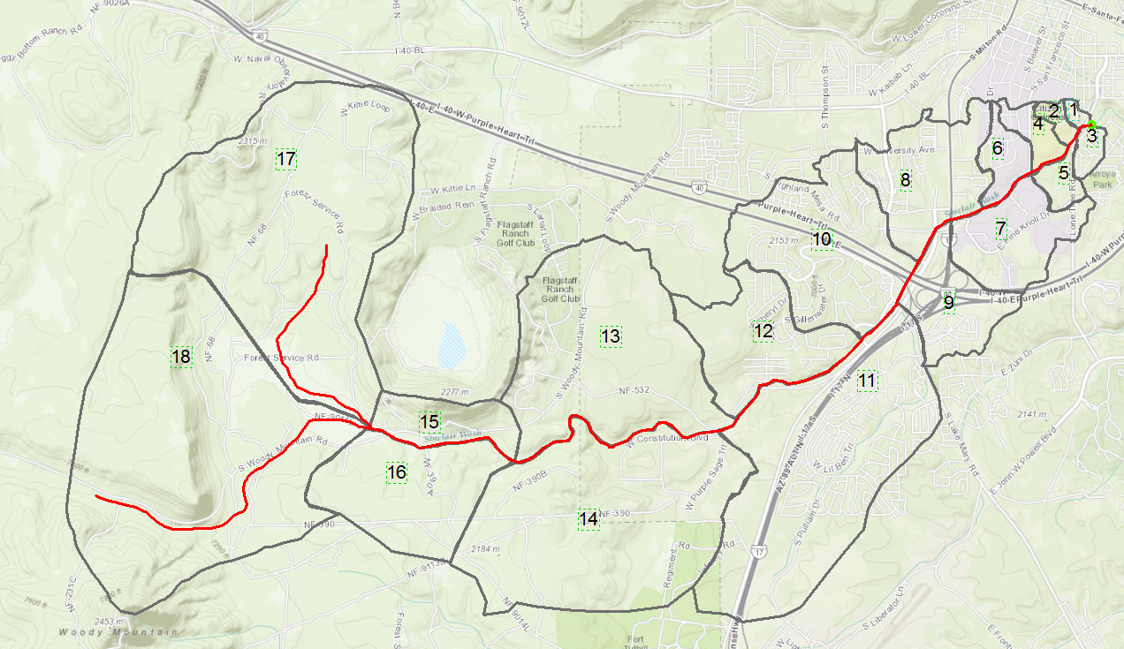
Hydrologic Analysis
Used ArcMap with 2013 city contours to delineate watershed
18 Sub-basins
City of Flagstaff requirements
24-hr storm duration for watersheds greater than 1sq mile
SCS Curve Number Method for soil loss
SCS Unit Hydrograph
SCS Type II rainfall distribution
Richardson

Slide 10
Hydrologic Analysis: SCS Curve Number
Area of each sub-basin
Soil Group D
Curve Number based on type of cover
Sub-basin | Area (miles^2) | Curve Number | Notes
1 | 0.02 | 95 | 80% impervious, 20% woods poor condition
2 | 0.04 | 82.35 | 60% open space fair condition, 6% impervious, 37% woods fair condition
3 | 0.05 | 87 | 1/4 acre residential lot sizes
4 | 0.09 | 92 | 50% paved, 50% woods poor condition
5 | 0.07 | 83.26 | 33% park good condition, 12% impervious, 55% woods fair condition
6 | 0.12 | 95.6 | 80% impervious, 20% woods poor condition
7 | 0.37 | 92.4 | 65% parking, 35% woods fair condition
8 | 0.49 | 94.9 | 80% impervious, 15% woods fair condition, 5% park fair condition
9 | 0.32 | 91.7 | 40% road, 60% open space poor condition
Richardson

Slide 11
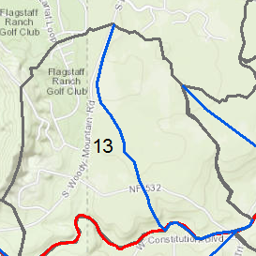


Hydrologic Analysis: SCS Unit Hydrograph
Length of Flow
Average slope of sub-basin
Overland Flow roughness coefficient
Sheet Flow
Shallow Flow
$$t_{c}=t_{sheet}+t_{shallow}+t_{channel}$$
$$t_{lag}=0.6t_{c}$$
Channel Flow
Richardson

Slide 12
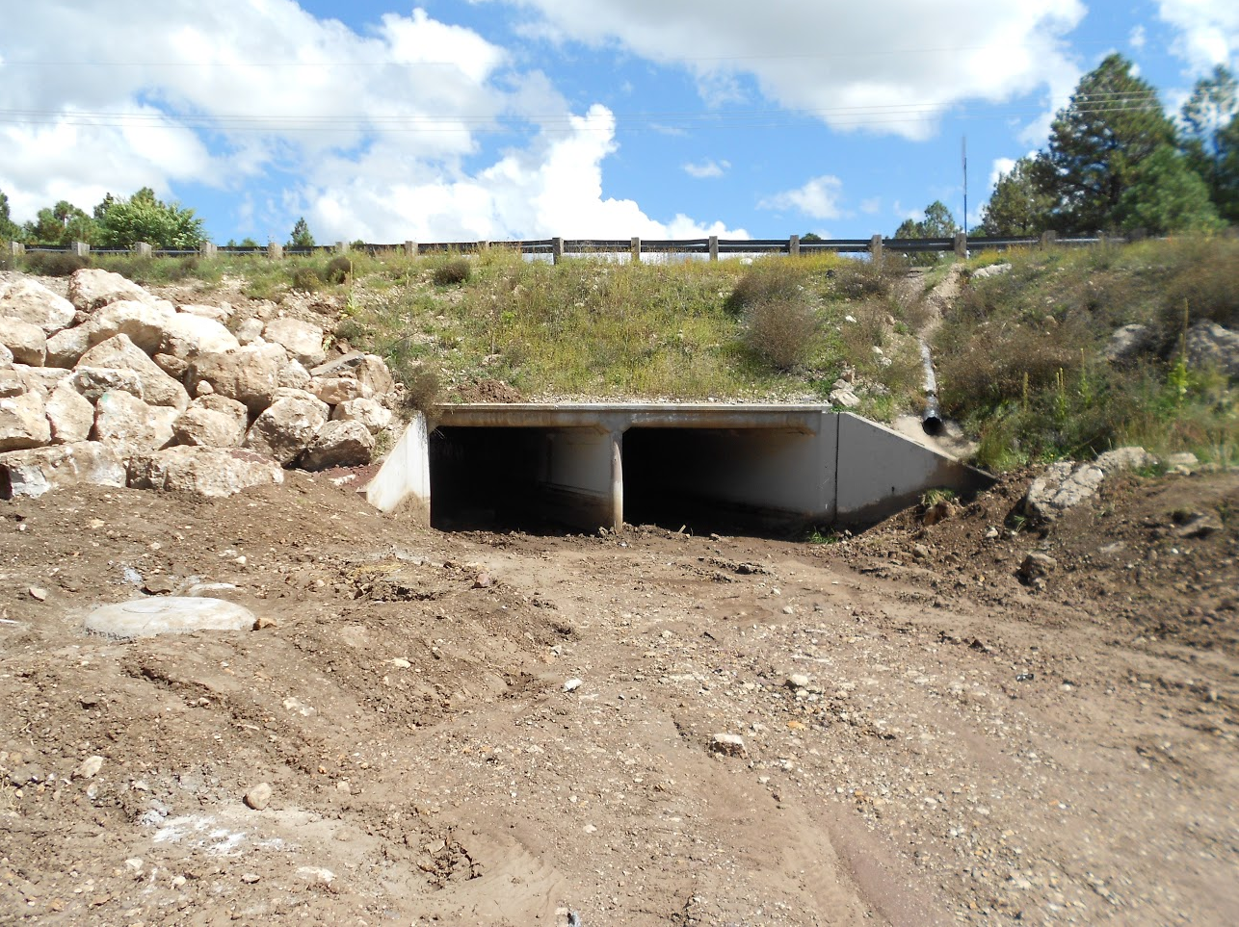
Hydrologic Analysis: HEC-HMS Results
Peak discharge at “Junction-2”
240cfs
Crossing under San Francisco St.
“Reach 4” had highest channel flow
220cfs
Flat area before San Francisco St.
Too Low!
Richardson

Slide 13
Hydraulic Analysis
Channels
5 sections of the wash
Imported alignment and sample line data into HEC-RAS
Manning’s Coefficient varied based on soil analysis
Culverts
100-year storm for sections at road crossings
50-year storm for sections at trail crossings
Richardson

Slide 14
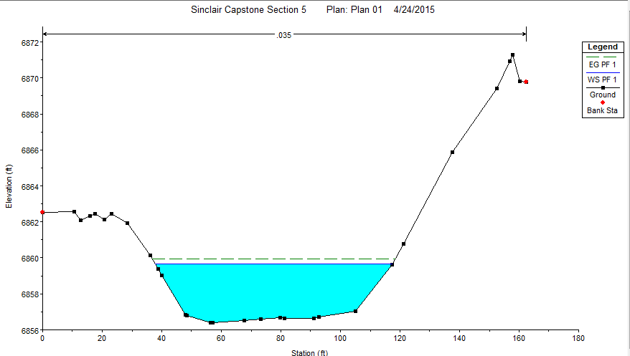
Hydraulic Analysis Results: Channels
Section Surveyed | Location | Average Free-Board for 100-Year Storm (ft)
1 | South part of University Drive | 1.5
2 | Big 5 | 3.5
3 | Walmart | 3.5
4 | East of I-40 | 3
5 | West of San Francisco | 2
Richardson

Slide 15
Hydraulic Analysis Results: Culverts
Culvert Analysis
Type | Reach | Crossing Type | Flow Capacity (cfs) | Storm Flow (cfs) | Pass/Fail
CMP | 3 | FUTS | 40.99 | 456.9 | Fail
CMP | 3 | FUTS | 93.02 | 456.9 | Fail
CMP | 3 | FUTS | 4.98 | 456.9 | Fail
CMP | 3 | FUTS | 49.08 | 456.9 | Fail
CMP | 3 | Road | 219.48 | 512.4 | Fail
Box | 4 | Road | 718.07 | 702.4 | Pass
CMP | 4 | Road | 1503.49 | 702.4 | Pass
CMP | 5 | Road | 2521.6 | 887.4 | Pass
CMP | 5 | Road | 1193.57 | 887.4 | Pass
CMP | 6 | FUTS | 31.58 | 791.4 | Fail
Box | 6 | Road | 879.63 | 887.4 | Fail
Box | 7 | Road | 1198.77 | 905.4 | Pass
CMP | 8 | FUTS | 5.68 | 848.3 | Fail
CMP | 8 | FUTS | 43.76 | 848.3 | Fail
Box | 8 | Road | 1513.44 | 951.3 | Pass
King

Slide 16
Cost of Engineering Services
Position | Hourly Billing Rate | Total Number of Hours | Cost
Project Manager | $83 | 176 | $14,547
Project Engineer: Hydrologist | $68 | 172 | $11,638
Engineer in Training | $53 | 142 | $7,456
Engineering Technician: Surveyor | $48 | 157 | $7,488
Total Hours: 653
Total Cost: $40,990
Swenson

Slide 17
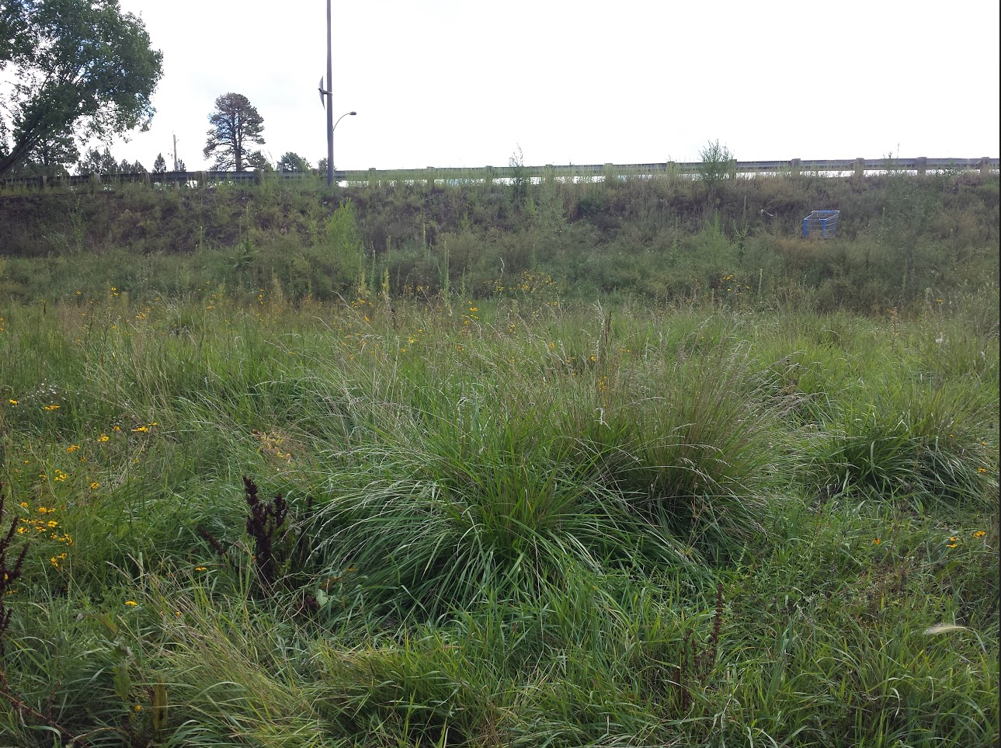
Broader Impacts
Increased importance placed on restoring wash
Identified health concerns
Building block for future projects involving wash
Swenson

Slide 18
Acknowledgements and References
Acknowledgements
Dr. Charles Schlinger
Mark Lamer
David McKee
References
[1] J. Sutter, "Arizona Department of Environmental Quality," 2010. [Online]. Available: http://www.azdeq.gov/environ/water/assessment/download/lg.pdf. [Accessed 2 November 2014].
[2] G. Hill, T. Hales and B. Aldridge, "Flood Hydrology Near Flagstaff Arizona," U.S. Geological Survey, Tucson, 1988.
[3] R. Hereford, "Climate History of Flagstaff, Arizona-1950 to 2007," U.S. Geological Survey, Flagstaff, 2007.
[4] King W. (2014). Sinclair Wash Project. Unpublished Manuscript, CENE 476 Capstone Preparation Northern Arizona University, United States.
[5] Provided by Client. Watersheds with Reaches.
[6] C. o. F.-GIS Department, The Rio de Flag Drainage Through the City of Flagstaff with Stream Team Reach Numbers, Flagstaff: City of Flagstaff.

Slide 19
